Slide 1


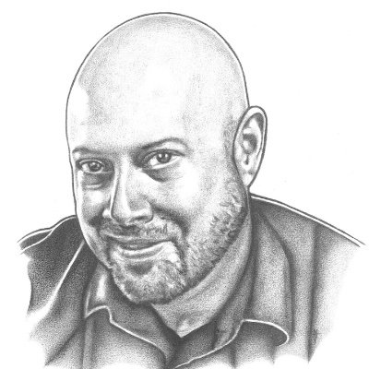




Speaker
Jason Helmick
Work smarter and improve automation with Predictive IntelliSense and PowerShell Crescendo
Jason Helmick
theJasonHelmick
September 16th & 17th
^{Online Event}
Powered By
International Conference

